Slide 1
React JS
(props)
Lecture-11

Slide 2
Today’s Agenda
What are props ?
Using Props In React
Some Important Points About Props
Exercise

Slide 3
What Are Props ?
Props stand for "Properties.“
It gives a way to pass data to a component.
It is an object which stores the value of attributes passed to a Component while rendering it and works similar to the HTML attributes.

Slide 4
How To Pass Props ?
If we are using Function Component , then to pass props we simply have to do the following
Make the function parametrized , having just one parameter .
This parameter can be called anything but it is conventionally named as props.
It will be an object and will receive attribute/values names passed to Component as its properties/values.
So we can access these properties , similar to the way we access any object’s properties
Finally while rendering the Component , we can pass attributes and values which will be converted to object by React and sent to props

Slide 5
Using Props In Functional Component
Index.html
<script type="text/babel">
function Greetings(props) {
return <h3>Good Evening {props.who}! </h3>;
}
let myDiv = document.querySelector("#root");
let root = ReactDOM.createRoot(myDiv);
root.render(<Greetings who="Sachin" />);
</script>

Slide 6
Passing Multiple Parameters
Index.html
<script type="text/babel">
function Greetings(props) {
return (
<h3>
Good Evening {props.who} from {props.from}!
</h3>
);
}
let myDiv = document.querySelector("#root");
let root = ReactDOM.createRoot(myDiv);
root.render(<Greetings who="Sachin" from="Amit" />);
</script>

Slide 7
Destructuring Props
Since props is an object , so we can use destructuring with it.
It will make our code simpler as then we can access the properties who and from without any dot operator

Slide 8
Destructuring Props
Index.html
<script type="text/babel">
function Greetings(props) {
const { who, from } = props;
return (
<h3>
Good Evening {who} from {from}!
</h3>
);
}
let myDiv = document.querySelector("#root");
let root = ReactDOM.createRoot(myDiv);
root.render(<Greetings who="Sachin" from="Amit" />);
</script>

Slide 9
A Special Point
If we just provide the attribute name on a component with nothing else, React will automatically pass a boolean value of true for that prop to the component.
This means that there is no need to write that a prop is equal to true.

Slide 10
Props Without Value
Index.html
<script type="text/babel">
function Greetings(props) {
console.log(props.who, props.from);
if (props.who && props.from) {
return <h1>Good Evening</h1>;
}
return null;
}
let myDiv = document.querySelector("#root");
let root = ReactDOM.createRoot(myDiv);
root.render(<Greetings who from/>);
</script>

Slide 11
Using Props In Class Component
If we are using Class Component , then to use props within the class or render() method we have write this.props .
The reason is that , props object is set as an instance member in our class by React.
Moreover , here unlike function component we cannot use any other name except props

Slide 12
Using Props In Class Component
Lets design a Class Component called Greetings , which will be called from App component along with the attributes who and from

Slide 13
Using Props In Class Component
Greetings.js
class Greetings extends React.Component {
render() {
return (
<h3>
Good Evening {this.props.who} from {this.props.from}!
</h3>
);
}
}

Slide 14
Using Props In Class Component
App.js
class App extends React.Component {
render() {
return (
<div>
<Greetings who="Varun" from="Deepak" />
</div>
);
}
}
let myDiv = document.querySelector("#root");
let root = reacrDOM.createRoot(myDiv);
root.render(<App />);

Slide 15
Using Props In Class Component
Index.html
<!DOCTYPE html>
<html lang="en">
<head>
<script
crossorigin
src="https://unpkg.com/react@18/umd/react.development.js"
></script>
<script
crossorigin
src="https://unpkg.com/react-dom@18/umd/react-dom.development.js"
></script>
<script src="https://unpkg.com/@babel/standalone/babel.min.js"></script>
<title>Using props with class components</title>
</head>
<body>
<div id="root"></div>
<script type="text/babel" src="Greetings.js"></script>
<script type="text/babel" src="App.js"></script>
</body>
</html>

Slide 16
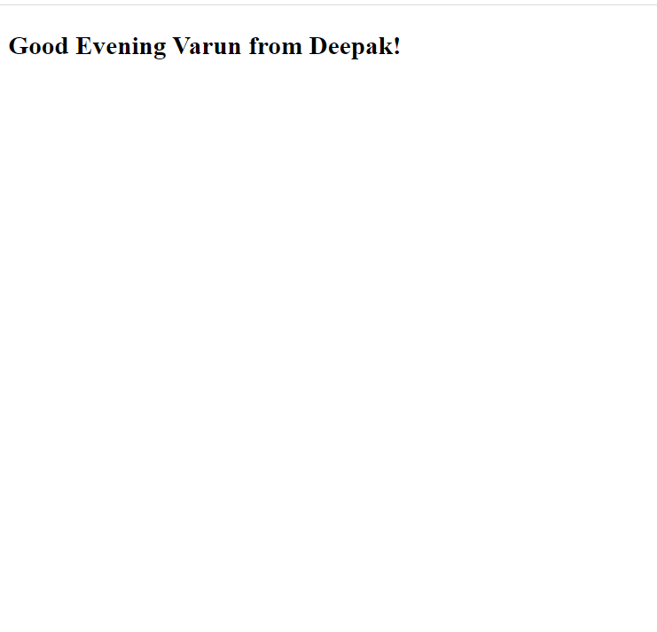
Output

Slide 17
A Very Important Point
Before moving any further we must remember two things about props:
Props are immutable or read only i.e we cannot change the value of props by assigning a new value to it.
We cannot add new properties to props object . In other words it means that props object is not extensible

Slide 18
Passing Non String Data
In most of the previous examples, the values of props were strings.
But often we would like to set props to values like numbers, booleans, objects, arrays, and even variables.

Slide 19
Passing Non String Data
React doesn’t put any restriction on what value a prop can have.
But , all values, have to be wrapped in curly braces like : prop={value}.

Slide 20
Passing Non String Data
App.js
class App extends React.Component {
render() {
return (
<div>
<Student
name="Varun"
age={15}
subjects={["phy", "chem", "maths"]}
marks={[40, 55, 60]}
isPass={true}
/>
</div>
);
}
}
let myDiv = document.querySelector("#root");
let root = reacrDOM.createRoot(myDiv);
root.render(<App />);

Slide 21
Passing Non String Data
Student.js
class Student extends React.Component {
render() {
console.log(this.props);
return (
<div>
<h3>Student details</h3>
<p>Name:{this.props.name}</p>
<p>Age:{this.props.age}</p>
<p>Subjects:{this.props.subjects.join()}</p>
<p>Marks:{this.props.marks.join()}</p>
<p>Result:{this.props.isPass.toString()}</p>
</div>
);
}
}

Slide 22
Passing Non String Data
Index.html
<!DOCTYPE html>
<html lang="en">
<head>
<script
crossorigin
src="https://unpkg.com/react@18/umd/react.development.js"
></script>
<script
crossorigin
src="https://unpkg.com/react-dom@18/umd/react-dom.development.js"
></script>
<script src="https://unpkg.com/@babel/standalone/babel.min.js"></script>
<title>Using props with class components</title>
</head>
<body>
<div id="root"></div>
<script type="text/babel" src=“Students.js"></script>
<script type="text/babel" src="App.js"></script>
</body>
</html>

Slide 23
Exercise
Create an React component called Emoji which accepts three emojis as props , displays them and if all three emojis are same then displays the message you win otherwise it should display the message you lose

Slide 24
Partial Solution
App.js
class App extends React.Component {
render() {
return (
<div>
<h3>Emoji Picker!!</h3>
<Emoji e1="😊" e2="😁" e3="😂" />
<Emoji e1="👍" e2="👍" e3="👍" />
<Emoji e1="🧨" e2="✨" e3="🎈" />
</div>
</div>
);
}
}
let myDiv = document.querySelector("#root");
let root = reacrDOM.createRoot(myDiv);
root.render(<App />);
.

Slide 25
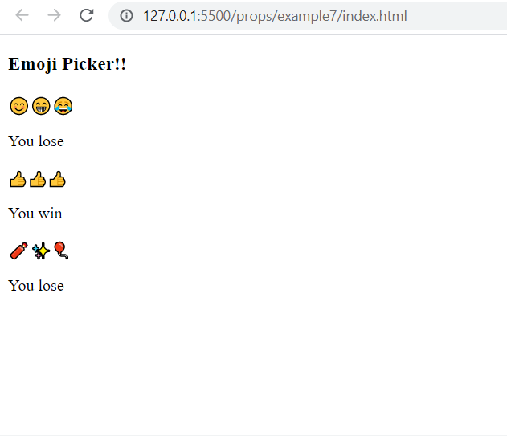
Output

Slide 26
Solution
Emoji.js
class Emoji extends React.Component {
render() {
const { e1, e2, e3 } = this.props;
const result = e1 == e2 && e2 == e3;
return (
<div>
<span>{e1}</span>
<span>{e2}</span>
<span>{e3}</span>
<p>{result ? "You win" : "You lose"}</p>
</div>
);
}
}
.

Slide 27
Html Page
Index.html
<!DOCTYPE html>
<html lang="en">
<head>
<title>Exercise</title>
<script
crossorigin
src="https://unpkg.com/react@18/umd/react.development.js"
></script>
<script
crossorigin
src="https://unpkg.com/react-dom@18/umd/react-dom.development.js"
></script>
<script src="https://unpkg.com/@babel/standalone/babel.min.js"></script>
</head>
<body>
<div id="root"></div>
<script type="text/babel" src="Emoji.js"></script>
<script type="text/babel" src="App.js"></script>
</body>
</html>
.

